Slide 1
Immigration and Urbanization in the United States
The American Pageant, Chapter 25

Slide 2
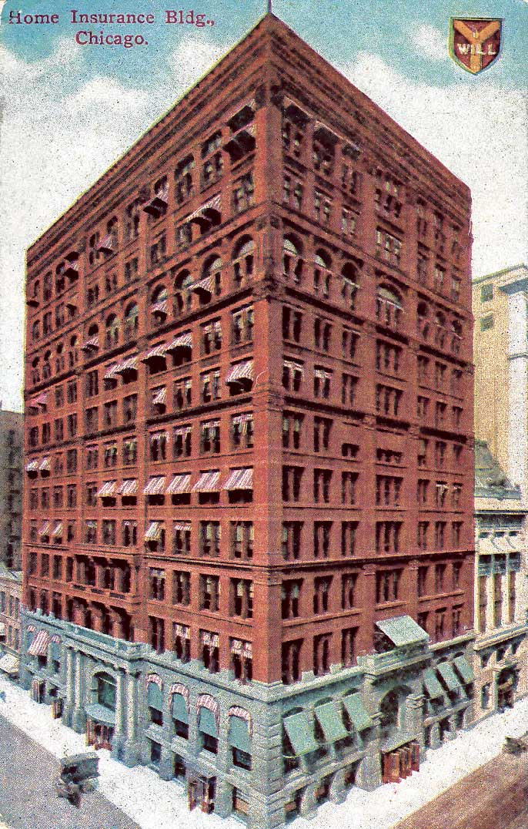
Growth of Cities
Cities (urbanization) grow immensely
1900—40% live in cities
1920—50%+ live in cities
Population doubles between 1870-1900
Why?
Jobs and opportunities
Immigration—Europe and Asia
Migration—leaving the farm for the city
African Americans—Great Migration**
Pursuit of happiness, leisure
First skyscraper, Chicago,
1885—perfected by elevator

Slide 3
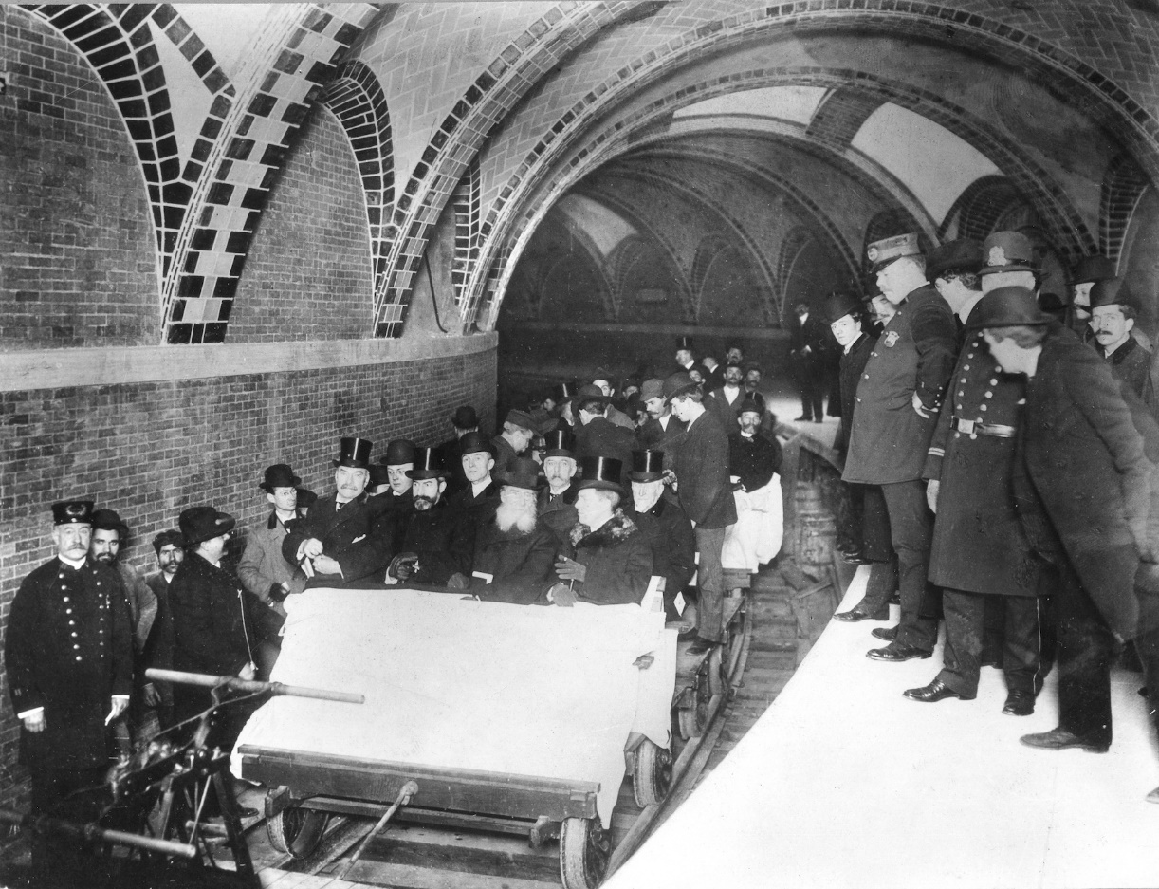
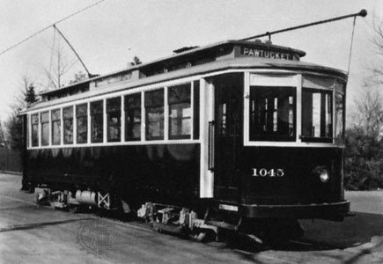
Growth of Cities
Why?
Technology
Skyscrapers (Chicago)
Steel, Bessemer Process
Electric Street Cars, subway systems, etc.
Quicker, cheaper transportation
Role of women changes
New jobs, economic opportunities
Clerical work

Slide 4
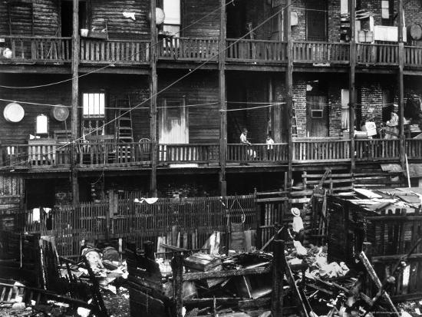
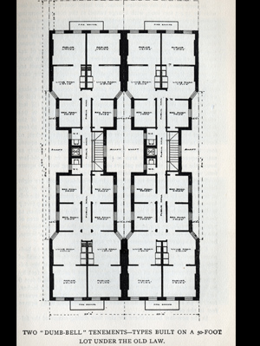
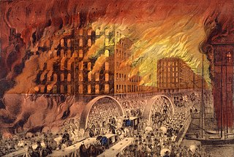
Problems in the City**
Overcrowding**
Tenement housing/slums
Segregation
Little Italy, Little Poland, Chinatown, etc.
Great Chicago Fire, 1871
Pollution**
Streets, water
Crime**
Poverty**

Slide 5
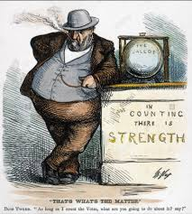
Political Bosses, Machine Politics**
Key Idea—CORRUPTION!**
Boss Tweed, Tammany Hall
How were they corrupt?**
Reward voters / donors
Jobs, electricity, police, etc.
You scratch my back, I'll scratch yours
Greed, graft, corruption, fraud
Thomas Nast—pictures!

Slide 6
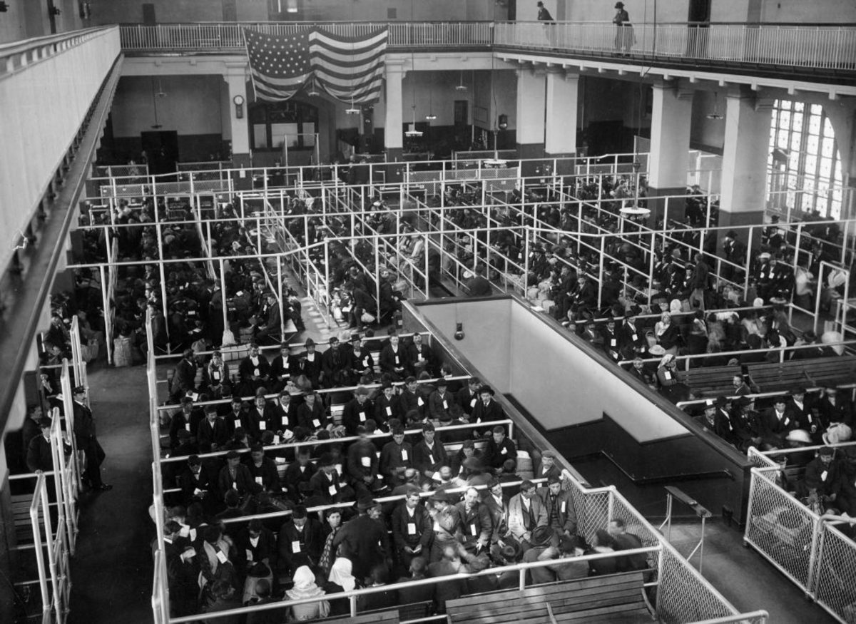
Immigration
“Old” and “New” Immigrants
What’s the difference?
Most immigrants are men; several go back home
Few intend to assimilate
Old Immigrants | New Immigrants
North, Western Europe | Eastern Europe
Protestant (some Catholic) | Catholic, Orthodox, Jewish
Literate, skilled | Illiterate, unskilled
Assimilated | Reluctant to assimilate
From democratic nations | Came from communist/anarchist
Not as poor | Poor

Slide 7
Push and Pull Factors of Immigration
Immigrants come for a reason!
Jobs and Culture**
PULL Factors**
Freedom, Jobs, Industry, Opportunity
PUSH Factors**
Loss of jobs/land, Poverty, Instability, Persecution
What may be YOUR pull factor, may be another person’s PUSH factor.

Slide 8
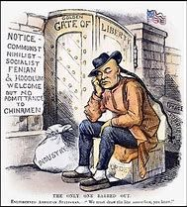
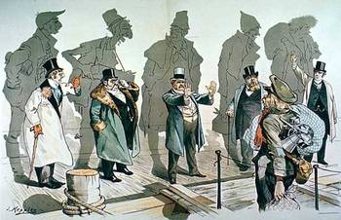
Response to Immigration
Immigrants from Europe—Ellis Island
Immigrants from Asia—Angel Island
Our response—nativism!**
Racially inferior
Competition for jobs
Changing our identity
Radical, religious, etc.
Melting Pot or Dumping Ground?

Slide 9
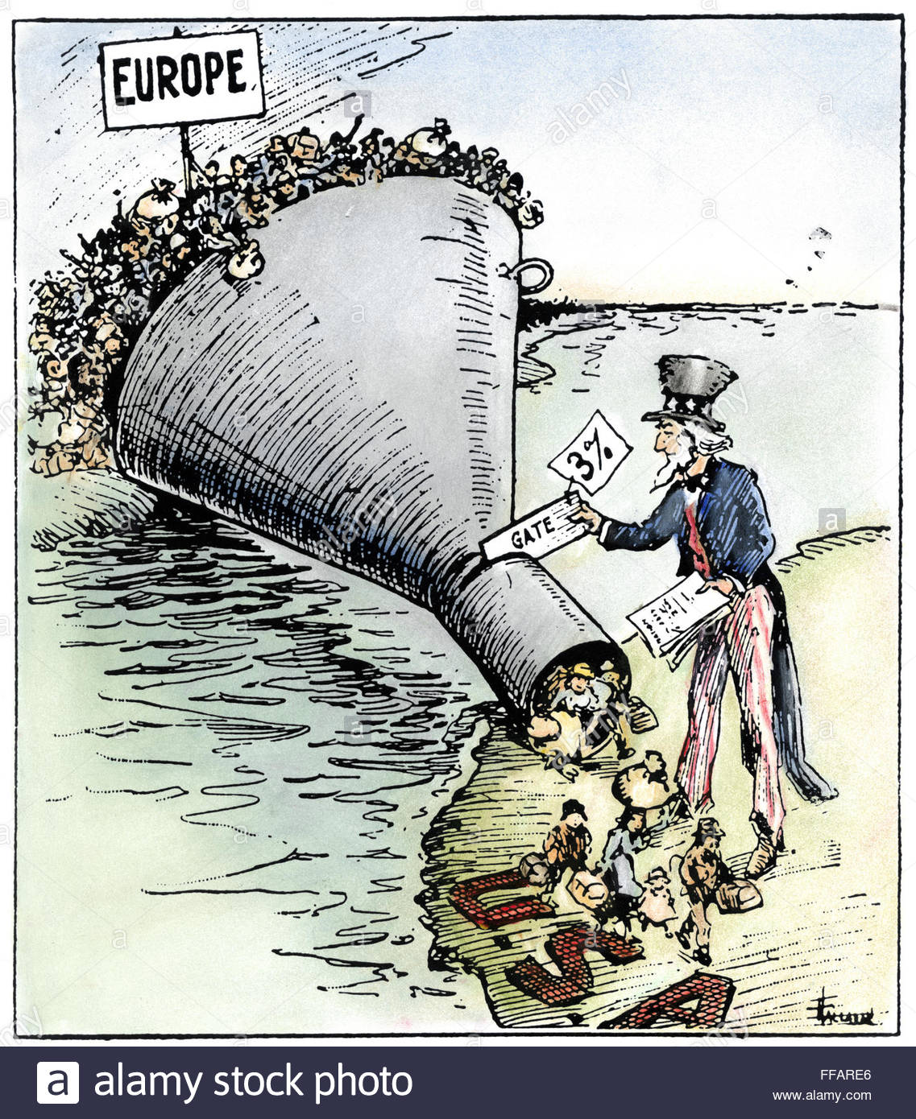
Response to Immigration
Limit immigration, rights
Chinese Exclusion Act**
American Protective Association
Protestant; anti-Catholic
Literacy Tests
Immigration Quota Act (1920s)

Slide 10
Meanwhile, in 1886…

Slide 11
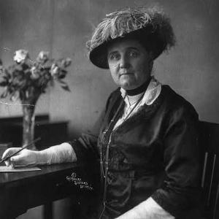
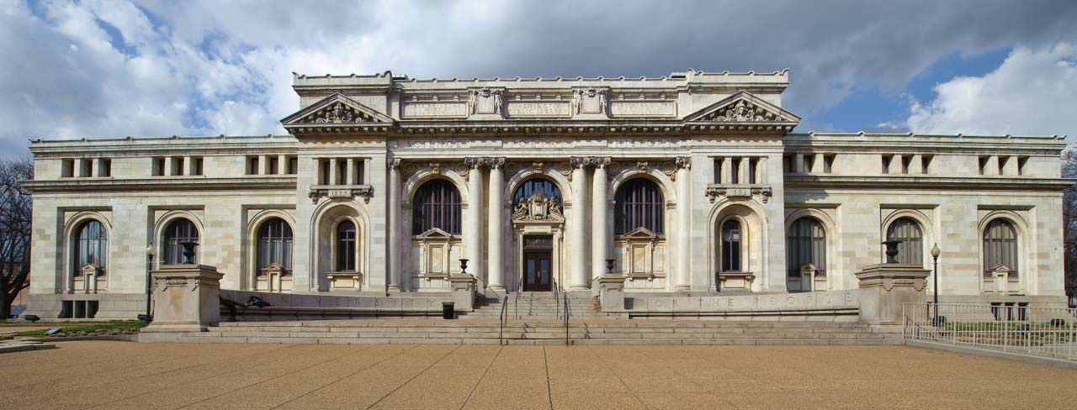
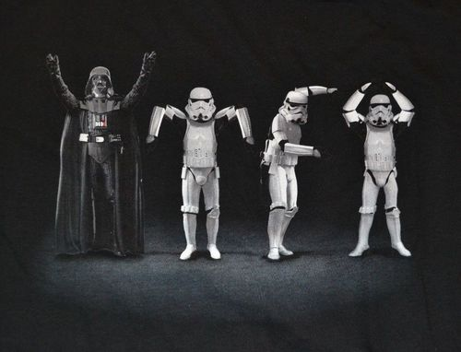
Response to Urbanization and Immigration
Problems with urbanization evident in society
How to deal with poverty?
Social Gospel Movement**
Salvation Army
YMCA
Philanthropy**
Settlement House**
Jane Addams
Secular improvement, not Christian improvement!
Goal—moral improvement, Christianization of USA, assimilation
Church growth slower in cities; seen as irrelevant
Darwin, Education and Religion
Still—by 1890, over 100 denominations

Slide 12
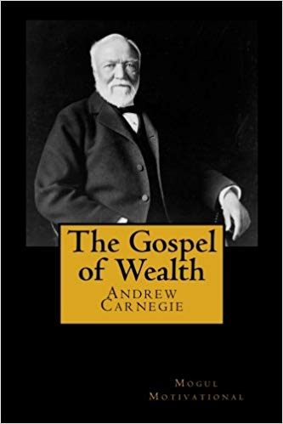
Belief Systems of the Industrial Revolution
Support and challenges to ideas of the Industrial Revolution
Colonial period—Protestant work ethic = work hard, be Godly
Horatio Alger—rags to riches story
Honesty and hard work lead to success
Reinforced by Carnegie**
Scottish Immigrant—true rags to riches
Most workers aren’t going to “riches”
Society is largely pro-big business
Social Gospel / Gospel of Wealth**

Slide 13
Belief Systems of the Industrial Revolution
Critics of industry
Gospel of Wealth, Social Darwinists, etc.
Henry George—Progress and Poverty
Inequalities in society due to laissez-faire, industry
Edward Bellamy—Looking Backward
Socialist society will “fix” problems
More information later, but understand….
Reform movements will take place

Slide 14
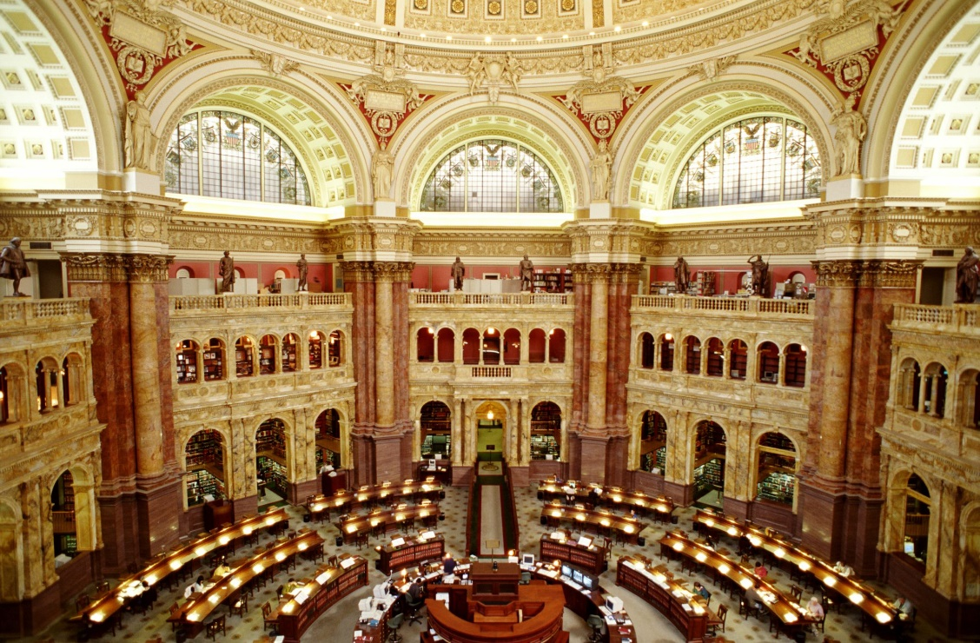
The Press and Education
Expansion of public schools
Less ignorant society, better government
1870—compulsory education
Education is now a birthright
Growth of Universities—secularism
Johns Hopkins, UCA, Ohio State, TAMU
Opportunities for women and Africans
Growth of libraries
Library of Congress
What to write about—”presstitutes”
Joseph Pulitzer, the Associated Press and Yellow Journalism**

Slide 15
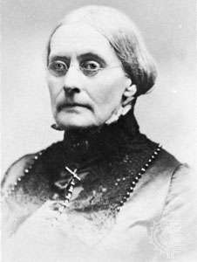
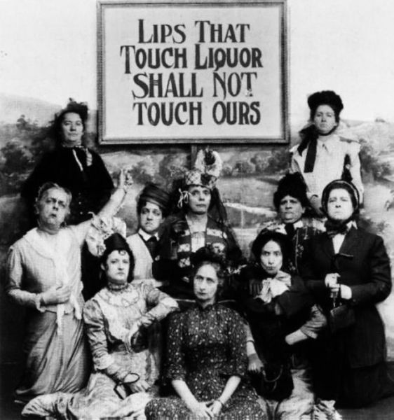
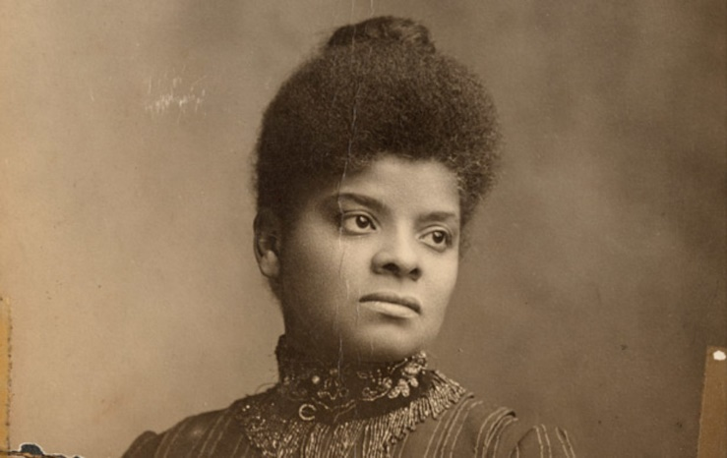
Women’s Role
Women—more present in school and workforce
Focus on reform efforts as well
NAWSA**
Susan B. Anthony
NWCTA**
Francis Willard
Ida B. Wells**

Slide 16
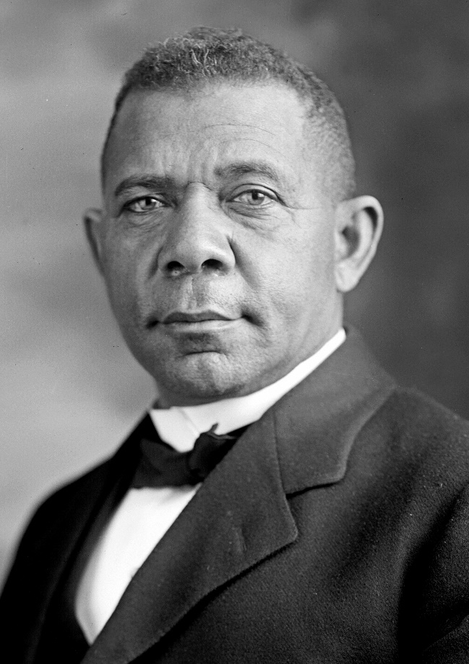
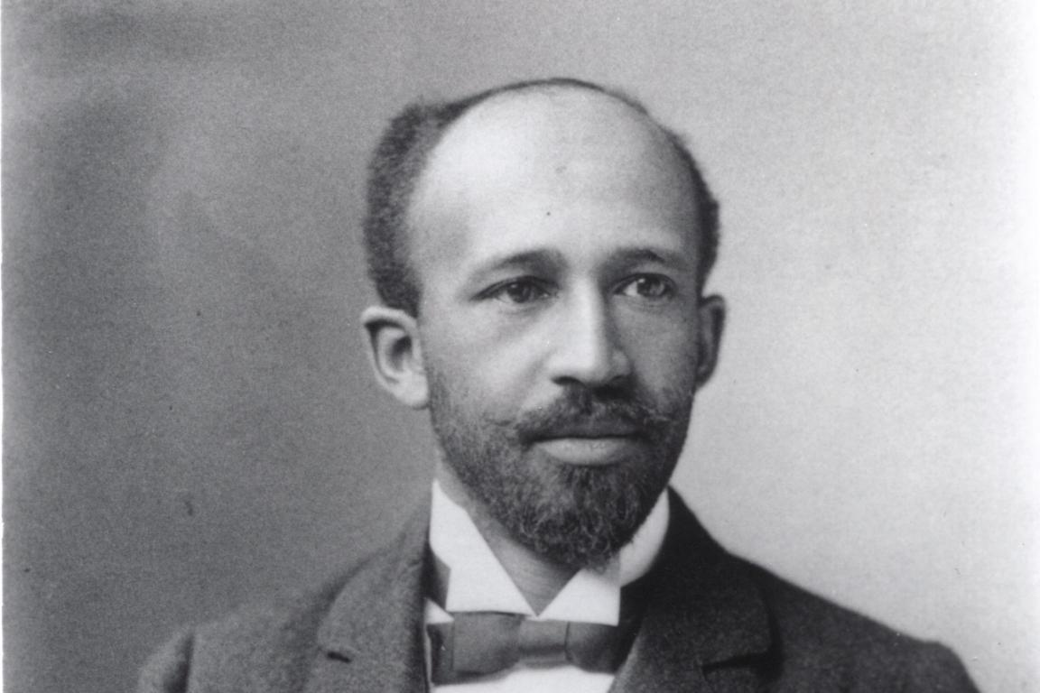
African Americans
Booker T. Washington**
Ex-slave
Up From Slavery
Need training in job skills (vocation)**
Gradual rights, not immediate
Tuskegee Institute
Does not challenge white supremacy
WEB DuBois**
From the North
PhD, Harvard
Created the NAACP**
Demands immediate political, social equality
The Souls of Black Folk

